Slide 1
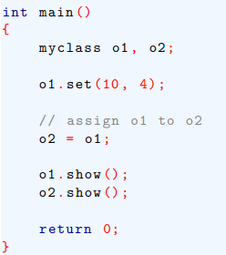
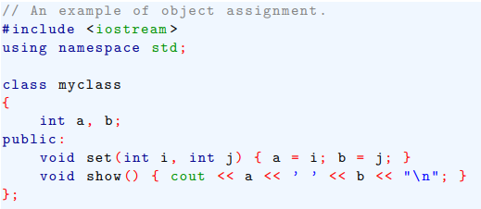
Assigning Objects
One object can be assigned to another provided that both objects are of the same type.
By default, when one object is assigned to another, a bitwise copy of all data members is made.
Here, the contents of object called o1is assigned to another object called o2, the contents of all of o1’s data are copied into equivalent members of o2.

Slide 2
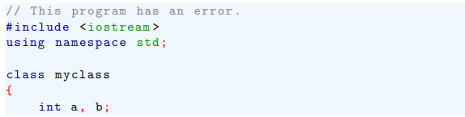
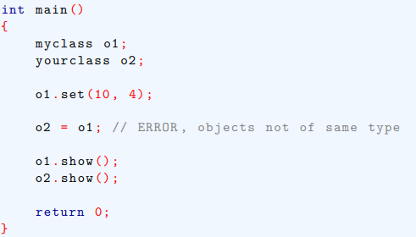

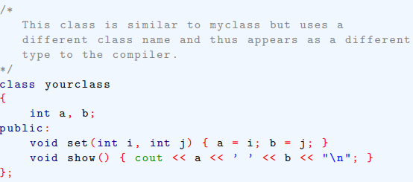
Assigning Objects
Following example shows a compile-time error..

Slide 3
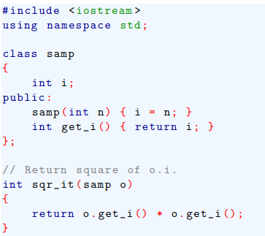
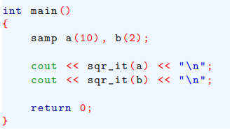
Passing Objects to Functions
Objects can be passed to functions as arguments in just same way that other types of data are passed.

Slide 4
Passing Objects to Functions
The default method of parameter passing in C++, including objects, is by value.
This means that a bitwise copy of the argument is made and it is this copy that is used by the function.
Therefore, changes to the object inside function do not affect the calling object.

Slide 5
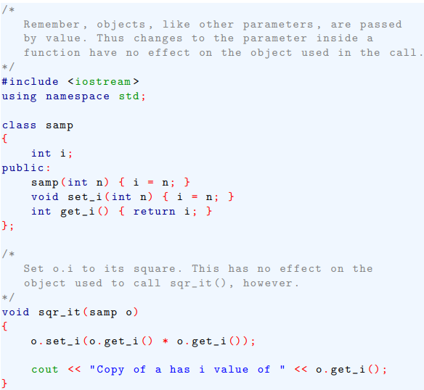
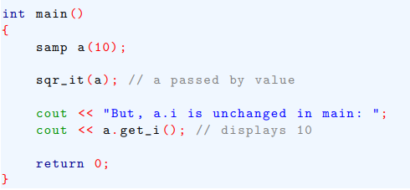

Passing Objects to Functions

Slide 6
Passing Objects to Functions
When a copy of an object is made when being passed to a function, it means that a new object comes into existence.
Also, when the function that the object was passed to terminates, the copy of the argument is destroyed.
This rises two questions. First, is the object’s constructor called when the copy is made?
Second, is the object’s destructor called when the copy is destroyed?

Slide 7
Passing Objects to Functions
When a copy of an object is made to be used in a function call, the constructor function is not called.
Because a constructor function is generally used to initialize some aspect of an object, it must not be called when making a copy of an already existing object passed to a function.
However, when the function terminates and the copy is destroyed, the destructor function is called.

Slide 8
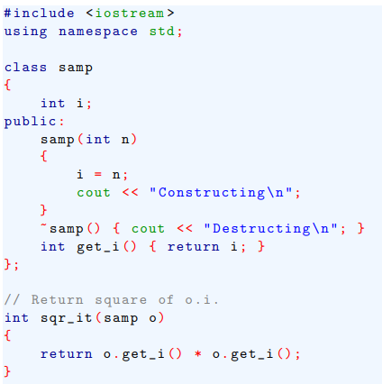
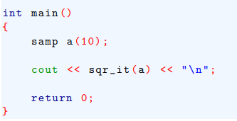
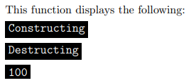

Passing Objects to Functions

Slide 9
Returning Objects from Functions
Just as you can pass objects to functions can return objects.
To do so, first declare the function as returning a class type.
Second, return an object of that type using the normal return statement.

Slide 10
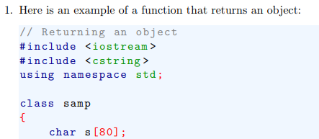
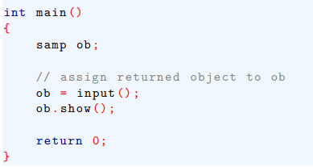
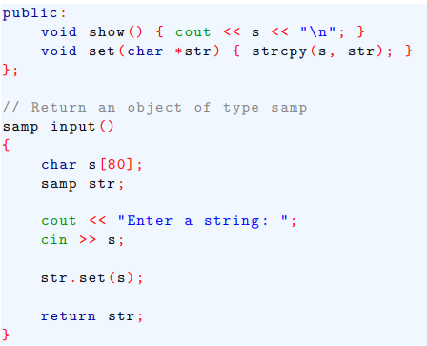
Returning Objects from Functions

Slide 11
Returning Objects from Functions
You must be careful about returning objects from functions if those objects contain destructor function.
For example, if the object returned by the function has a destructor that frees dynamically allocated memory , that memory will be freed even though the object that is assigned the return value is still using it.

Slide 12
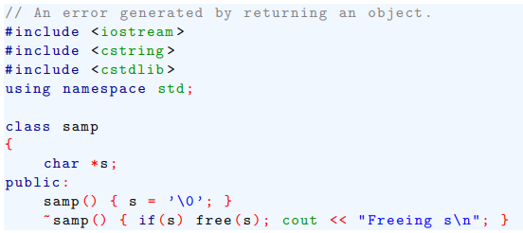
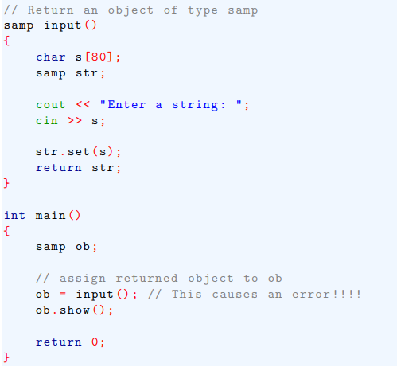
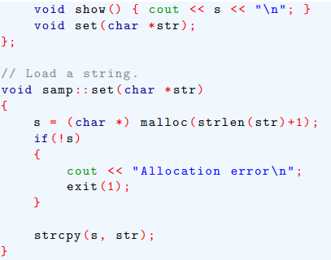
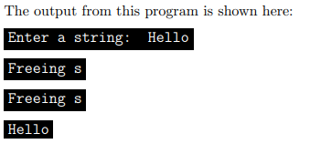

Returning Objects from Functions
For example, consider this incorrect version of the preceding program:

Slide 13
Returning Objects from Functions
Notice that samp’s destructor is called three times.
First, it is called when the local object str goes out of scope when input( ) returns.
Second, time ~samp( ) is called when temporary object returned by input( ) is destroyed.
Finally, the destructor for the object ob, inside main(), is called when the program terminates.

